Slide 1
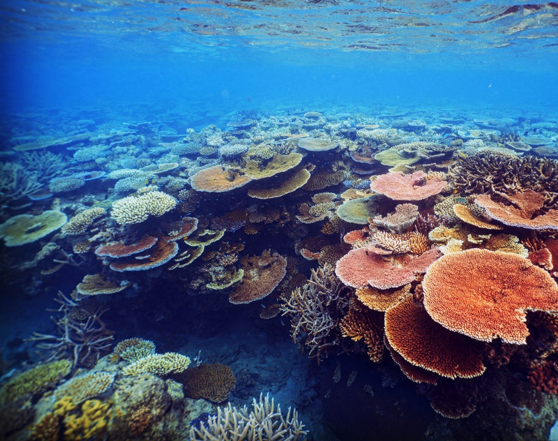
Climate change and the future of marine seascapes in the Anthropocene
Dr George Roff
(25th July 2025)
Curtin University

Slide 2
Climate change and the future of marine seascapes in the Anthropocene
1. Research background
2. Climate change and marine heatwaves
3. Emerging research themes

Slide 3
1. Introduction and background
Marine ecologist
Field scientist
coral reefs seagrass, mangroves, coastal fisheries
Scientific lead / operations lead
ADAS level 1, dive officer
>2000hrs underwater (Indo-Pacific, Caribbean)
remote pilot license (drones)
spatial ecology
disturbance ecology
community ecology
population dynamics
theoretical ecology
Naturalist
patterns and observations underpin ecological mechanisms and processes
“The more you observe nature, the more you realise how much you do not know” Gilbert White (1720-1793)
Academic
Teaching (undergrad)
Lecturers & field courses
Academic supervisor (Hons / PhD)
Stakeholder engagement
Traditional owner engagement
Data scientist
ecological modelling, Bayesian statistics
R, python, Julia, open science frameworks
Data visualisation
Decision support tools

Slide 4

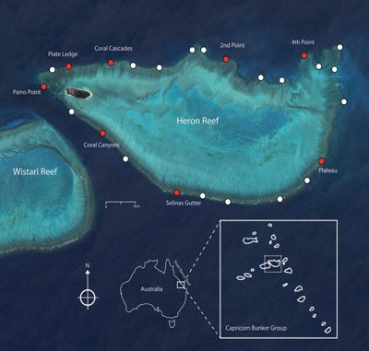
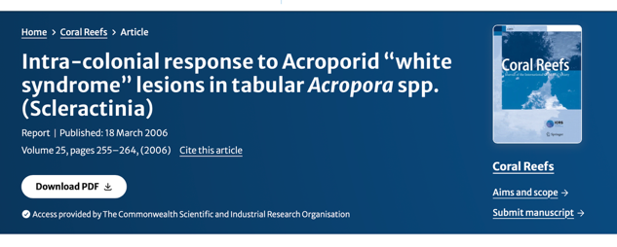
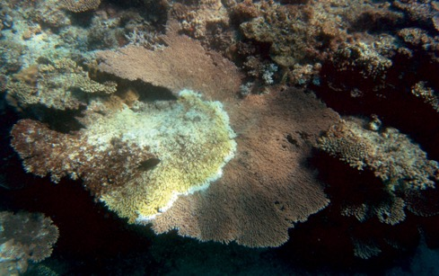
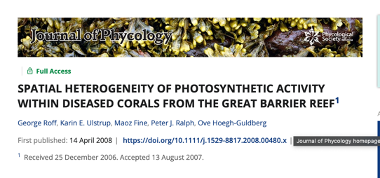
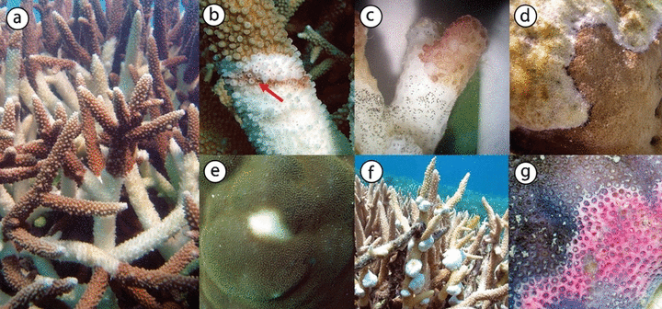
1. Research background & timeline
Sea Surface Temperature Anomalies, Great Barrier Reef (OISST)
2000
2005
2010
2015
2020
2025
Disease ecology
Great Barrier Reef
BSc (Hons) UQ

Slide 5
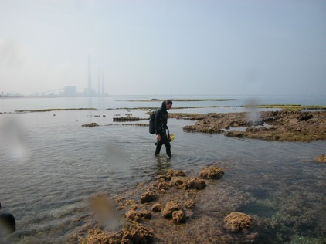
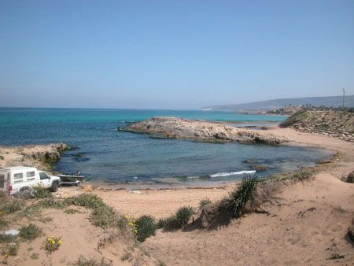
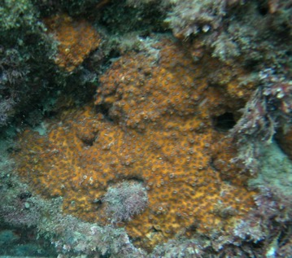
1. Research background & timeline
Sea Surface Temperature Anomalies, Great Barrier Reef (OISST)
2000
2005
2010
2015
2020
2025
Disease ecology
Great Barrier Reef
BSc (Hons) UQ
Research Assistant (Haifa, Isreal)
Invasive ecology
Mediterranean, Red Sea

Slide 6
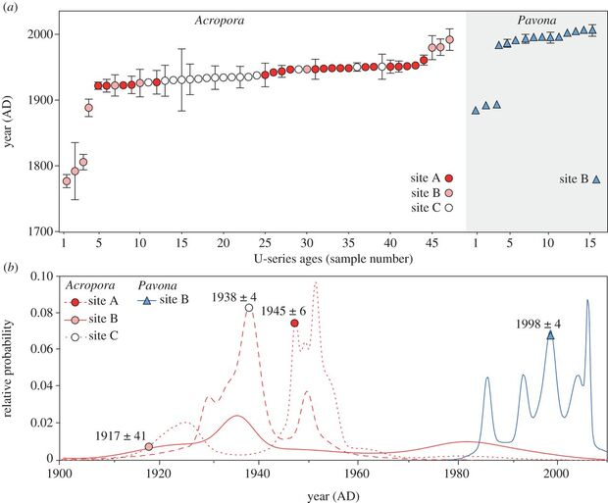
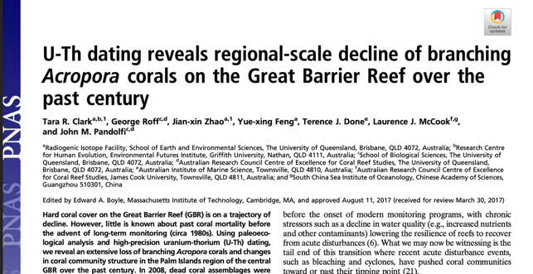
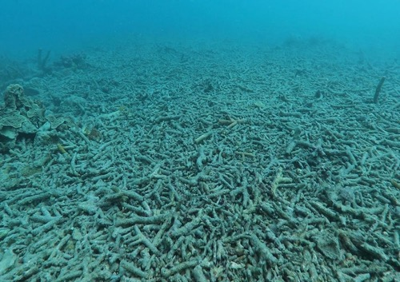
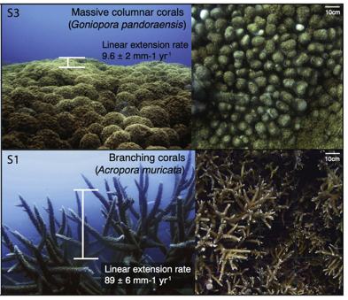
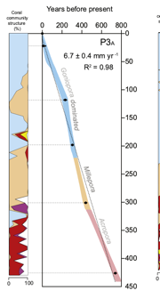
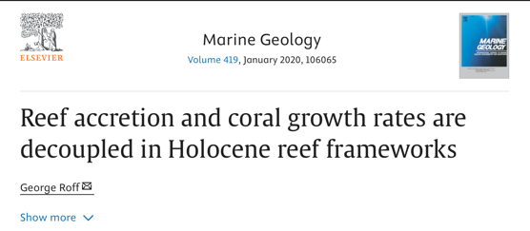
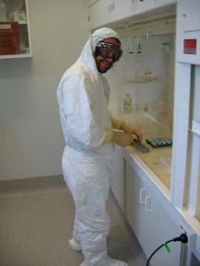
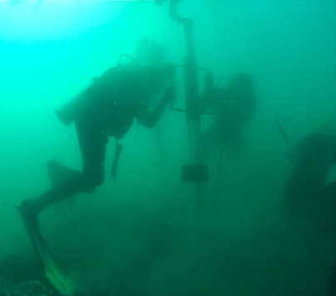
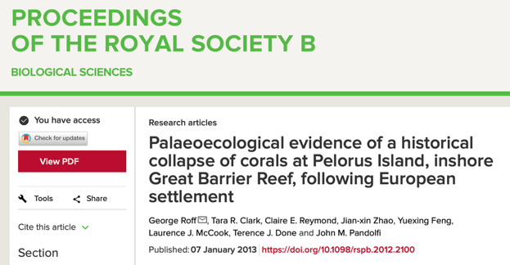
1. Research background & timeline
Sea Surface Temperature Anomalies, Great Barrier Reef (OISST)
2000
2005
2010
2015
2020
2025
Disease ecology
Great Barrier Reef
BSc (Hons) UQ
PhD (UQ)
Palaeoecology
Inshore GBR
Geochronology
(U-Th dating)
Palaeoecology
Shifting baselines and historical ecology

Slide 7
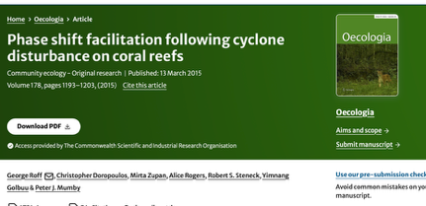
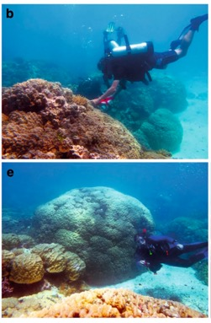
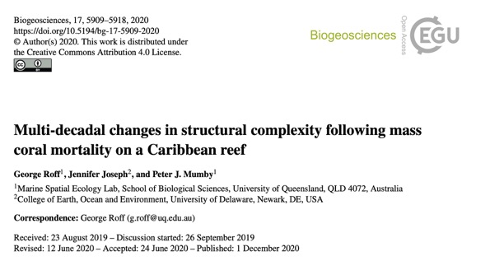
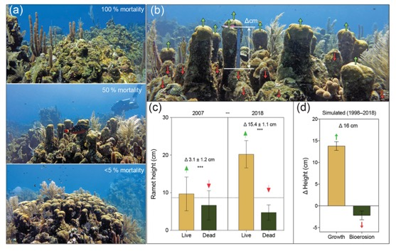
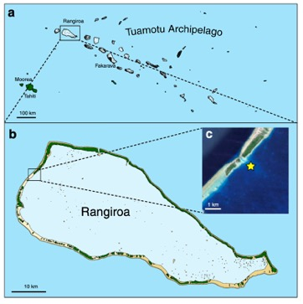
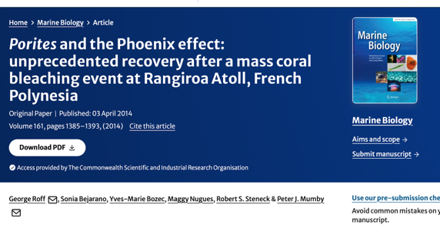
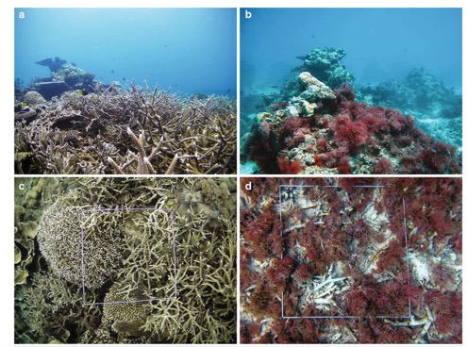
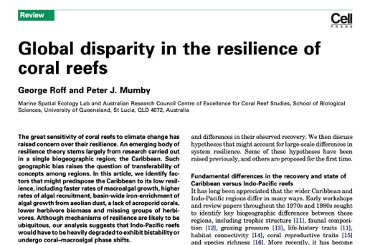
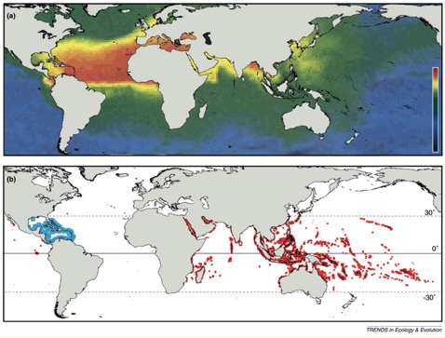
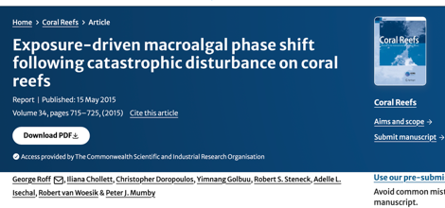
1. Research background & timeline
Sea Surface Temperature Anomalies, Great Barrier Reef (OISST)
2000
2005
2010
2015
2020
2025
Disease ecology
Great Barrier Reef
BSc (Hons) UQ
PhD (UQ)
Palaeoecology
Inshore GBR
Postdoctoral fellow (UQ)
Coral Reef Ecology
GBR, Caribbean

Slide 8
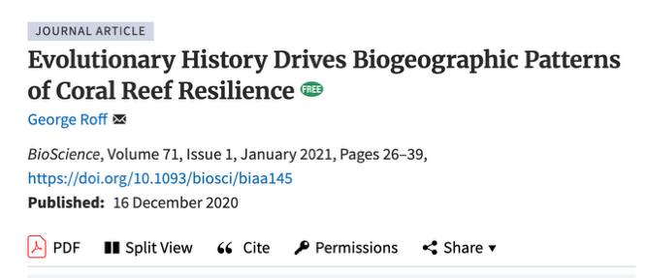
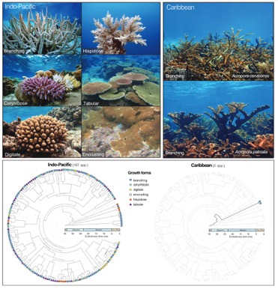
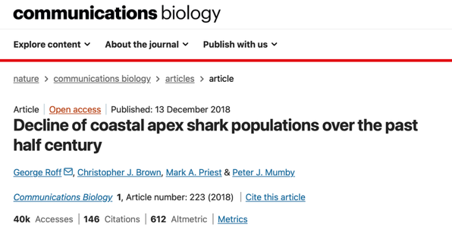
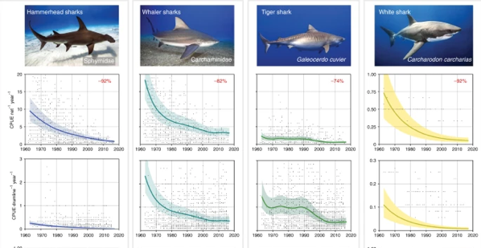
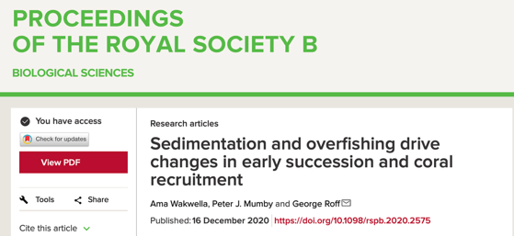
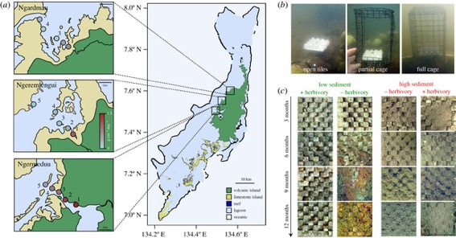
1. Research background & timeline
Sea Surface Temperature Anomalies, Great Barrier Reef (OISST)
2000
2005
2010
2015
2020
2025
Disease ecology
Great Barrier Reef
BSc (Hons) UQ
PhD (UQ)
Palaeoecology
Inshore GBR
Postdoctoral fellow (UQ)
Coral Reef Ecology
GBR, Caribbean
Senior research fellow
Spatial ecology
Indo-Pacific

Slide 9
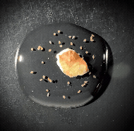
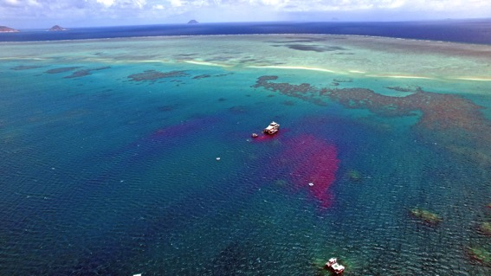
1. Research background & timeline
Sea Surface Temperature Anomalies, Great Barrier Reef (OISST)
2000
2005
2010
2015
2020
2025
Disease ecology
Great Barrier Reef
BSc (Hons) UQ
PhD (UQ)
Palaeoecology
Inshore GBR
Postdoctoral fellow (UQ)
Coral Reef Ecology
GBR, Caribbean
Senior research fellow
Spatial ecology
Indo-Pacific
Senior Scientist (CSIRO/SCU)
Reef restoration
Indo-Pacific
<1mm coral larvae
>1km scales of restoration

Slide 10
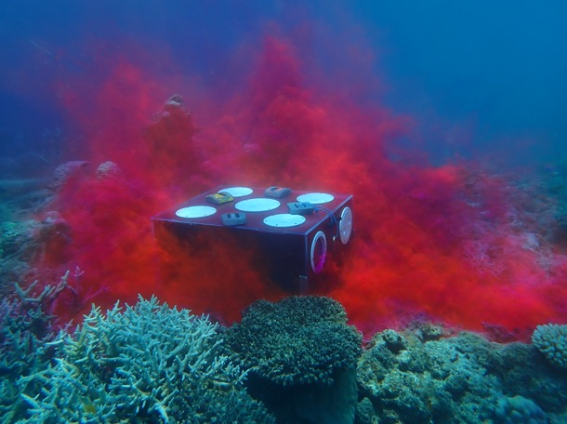
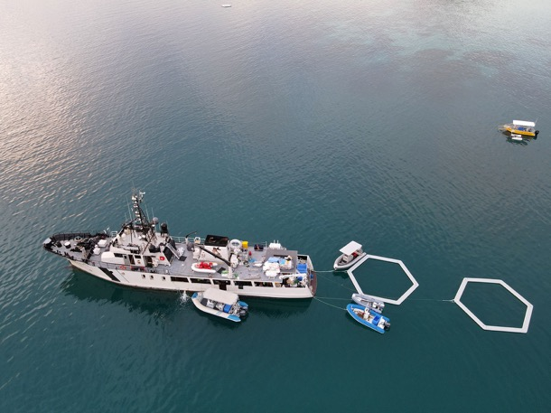

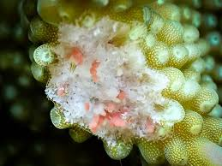


1. Research background & timeline
Senior Scientist (CSIRO/SCU)
Reef restoration
Indo-Pacific
Applied research
Identifying spawning windows
Mass-scale culture of coral larvae
Upscaling larval releases for restoration

Slide 11
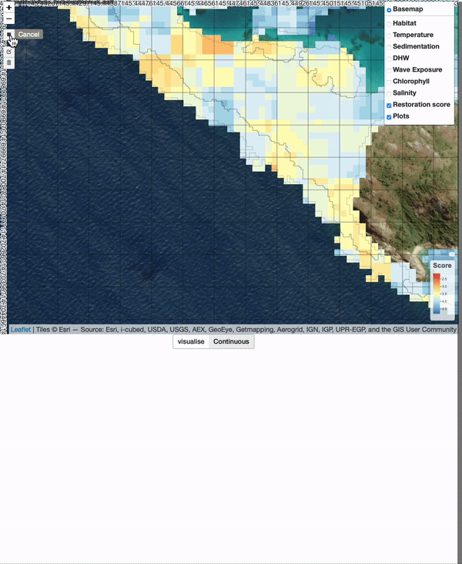

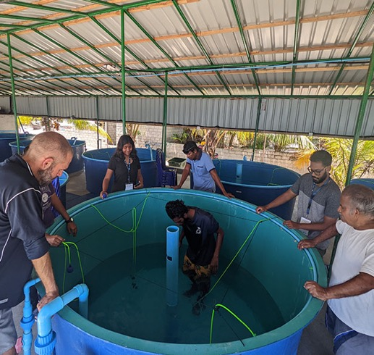
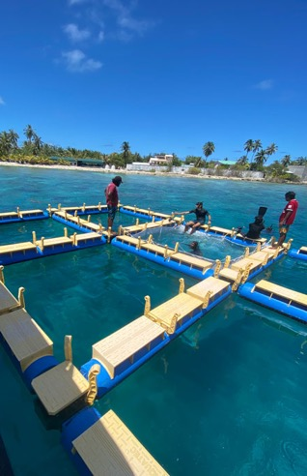
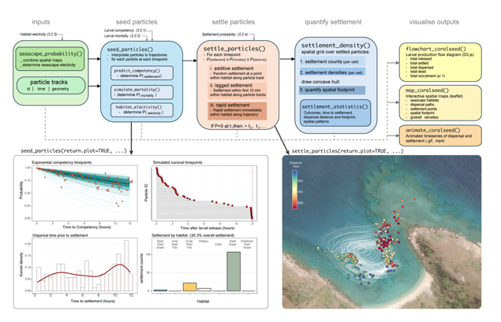
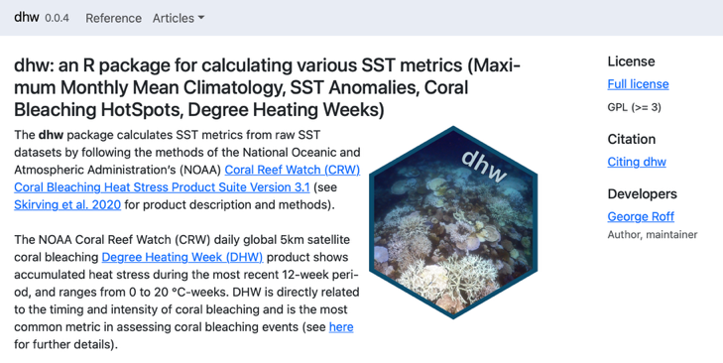


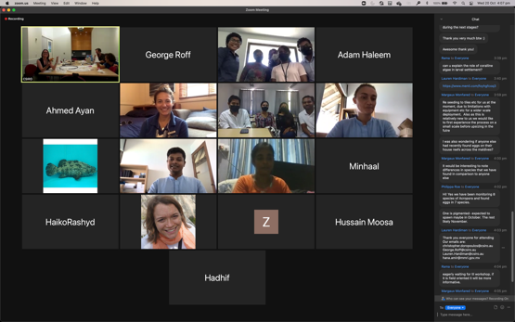
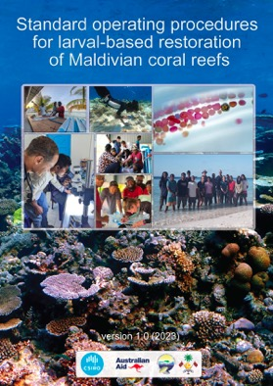
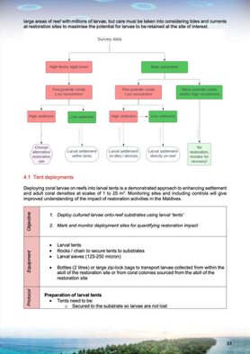
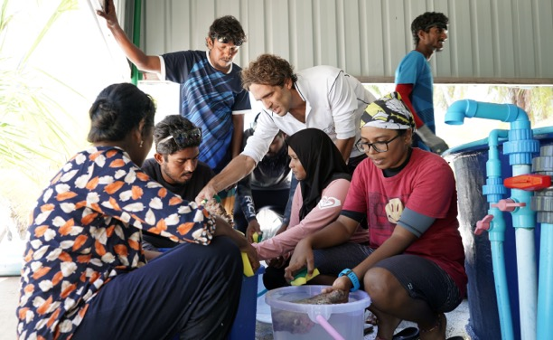
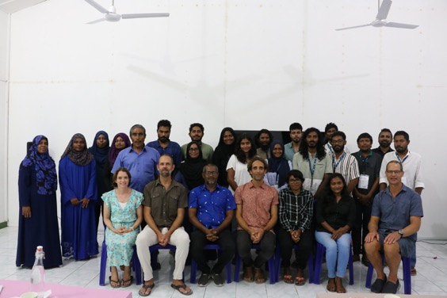
1. Research background & timeline
Decision support tools
Senior Scientist (CSIRO/SCU)
Reef restoration
Indo-Pacific
Applied research
Spatial modelling
‘coralseed’ model
R package development

Slide 12
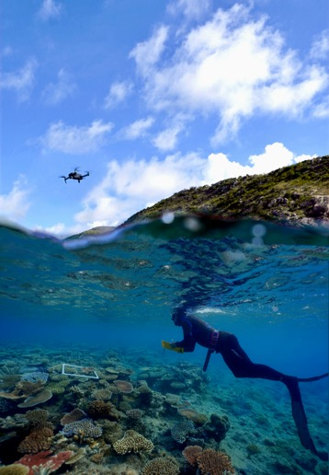


1. Research background & timeline
Senior Scientist (CSIRO/SCU)
Reef restoration
Indo-Pacific
Applied research
Spatial modelling
Field operations
Field lead
Marine & drone ops
ADAS level 1 commercial
(>2000hrs underwater)
CSIRO dive officer
Legislation & policy

Slide 13









1. Research background & timeline
Senior Scientist (CSIRO/SCU)
Reef restoration
Indo-Pacific
Applied research
Spatial modelling
Field operations
Teaching and outreach
Traditional Owner engagement (GBR)
Local councils, government,
school teachers (Maldives)

Slide 14

1. Research background & timeline
Sea Surface Temperature Anomalies, Great Barrier Reef (OISST)
2000
2005
2010
2015
2020
2025
Disease ecology
Great Barrier Reef
BSc (Hons) UQ
PhD (UQ)
Palaeoecology
Inshore GBR
Postdoctoral fellow (UQ)
Coral Reef Ecology
GBR, Caribbean
Senior research fellow
Spatial ecology
Indo-Pacific
Senior Scientist (CSIRO/SCU)
Reef restoration
Indo-Pacific

Slide 15









2. Marine heatwaves on the Great Barrier Reef (2024)

Slide 16




2. Marine heatwaves on the Great Barrier Reef
Increasing frequency and intensity of coral bleaching events (1998-2025)

Slide 17

2. Marine heatwaves on the Great Barrier Reef

Slide 18




2. Marine heatwaves and Western Australia
Kimberly Marine Park (Saltwater Country)
2016
Ningaloo Reef
2013

Slide 19
3. Future research directions
Anthropocene projections for the Western Australian coastline:
Record thermal stress in 2025
CMIP6 projections for increasing marine heatwaves
Increasing coastal populations, minerals extractions
unique “natural experiment” across Western Australian coastline
range expansions
productivity shifts
connectivity rewiring
Seascape ecology
“spatial patterns and ecological processes across marine and coastal environments”
managing marine systems as spatial mosaics under climate change
Integrate field, experimental, and modelling approaches to understanding ecological change

Slide 20





3. Future research directions
Seascape ecology
Spatial heterogeneity: variation in habitat types (coral reefs, seagrass)

Slide 21




3. Future research directions
Seascape ecology
Spatial heterogeneity: variation in habitat types
Temporal heterogeneity: variation in communities through time

Slide 22


3. Future research directions
Seascape ecology
Spatial heterogeneity: variation in habitat types
Temporal heterogeneity: variation in communities through time
Connectivity: movement of organisms, larvae, nutrients across seascapes

Slide 23


3. Future research directions
Seascape ecology
Spatial heterogeneity: variation in habitat types
Temporal heterogeneity: variation in communities through time
Connectivity: movement of organisms, larvae, nutrients across seascapes
Processes: how patterns influence biodiversity, trophic interactions, recruitment

Slide 24

3. Future research directions
Seascape ecology
Spatial heterogeneity: variation in habitat types
Temporal heterogeneity: variation in communities through time
Connectivity: movement of organisms, larvae, nutrients across seascapes
Processes: how patterns influence biodiversity, trophic interactions, recruitment
i) Range shifts in corals on the Western Australian coast
Connectivity (oceanparcels)
Plankton surveys (eDNA), recruitment tiles
Latitudinal translocations

Slide 25

3. Future research directions
Seascape ecology
Spatial heterogeneity: variation in habitat types
Temporal heterogeneity: variation in communities through time
Connectivity: movement of organisms, larvae, nutrients across seascapes
Processes: how patterns influence biodiversity, trophic interactions, recruitment
i) Range shifts in corals on the Western Australian coast
Connectivity (oceanparcels)
Plankton surveys (eDNA), recruitment tiles
Latitudinal translocations
ii) Marine Protected Areas under predicted climate change
Habitat distributions
CMIP6 climate projections
Identify refugia and under-representation

Slide 26




3. Future research directions
Seascape ecology
funding
ARC Discovery (DP180102526) (2018-2022)
National Environmental Research Program (NERP) (2011-2015)
National Environmental Science Program 5.7 (NESP) (2007-2011)
The Ocean Conservancy Fellowship (2007-2010)
Mia J Tegner fellowship (2009-2011)
GBRMPA Science for Management (2009)
Collaborative space
TrEnD
Lab
CORE
Research
Group
Institute for
Data
Science
Seascape
Ecology
Future funding
ARC Discovery / ARC Future Fellowship program
Industry collaboration
NGO engagement
Philanthropic funding
External consulting
Fish
Ecology
Lab
Remote Sensing & Satellite Research Group
Spatial
sciences
Notes:
RSSRG – sealevel rise, tide datum, analytical spatial geoscience

Slide 27



3. Future research directions
Science for impact
Applied science
Decision support tools
Policy outcomes
Collaborative
Interdisciplinary methods
Integrative approaches
Traditional owner engagement
Educational science
Integrating research with undergraduate learning
Science communication and outreach
Field-based science
Observation driven science
- Supporting OHS frameworks, policy change
Scientific integrity
Open source framework and data sharing
Diversity
Ecological ethics

Slide 28



Acknowledgments
Faculty of Science and Engineering, Curtin University
Reef Restoration Adaptation Program
CSIRO Environment
Southern Cross University
Maldives Marine Research Institute

